Slide 1

JAVA SCRIPT

Slide 2
INTRODUCTION
JavaScript (js) is a light-weight object-oriented programming language which is used by several websites for scripting the webpages.
It is an interpreted, full-fledged programming language that enables dynamic interactivity on websites when applied to an HTML document.

Slide 3
HISTORY
JavaScript was invented by Brendan Eich in 1995
It was developed for Netscape 2, and became the ECMA-262 standard in 1997.

Slide 4
FEATURES OF JAVA SCRIPT
JavaScript is an object-oriented programming language that uses prototypes rather than using classes for inheritance.
It is a light-weighted and interpreted language.
It is a case-sensitive language.
JavaScript is supportable in several operating systems including, Windows, macOS, etc.

Slide 5
APPLICATION OF JAVA SCRIPT
JavaScript is used to create interactive websites. It is mainly used for:
Client-side validation,
Dynamic drop-down menus,
Displaying date and time,
Displaying pop-up windows and dialog boxes (like an alert dialog box, confirm dialog box and prompt dialog box),
Displaying clocks etc.

Slide 6
JAVA SCRIPT EXAMPLE
<script type="text/javascript" >
document.write("Hello JavaScript ");
</script>

Slide 7
TYPES OF JAVASCRIPT
Inline JavaScript
Internal JavaScript
External JavaScript

Slide 8
1.Inline JavaScript
Write the function inside the <tag>
Example :
<h1 onclick=“javascript:alert(InlineJS)”>hello world</h>
2.Internal JAvaScript
Write JavaScript function with in the body
Example :
<script type="text/javascript">
alert("Hello Synnefo");
</script>

Slide 9
External JavaScript
An external JavaScript file must be saved by .js extension. It is recommended to embed all JavaScript files into a single file.
Example :
Script.js
alert(“welcome Synnefo”)
Index.html
<script src=“Script.js”></script>

Slide 10
Comments in Java Script
Single Line Comment
//Comment
Multi Line Comment
/* welcome
to
JavaScript */

Slide 11
Variable in Java Script
A JavaScript variable is simply a name of storage location.
There are two types of variables in JavaScript :
local variable and global variable.
There are some rules while declaring a JavaScript variable (also known as identifiers).
Name must start with a letter (a to z or A to Z), underscore( _ ), or dollar( $ ) sign.
After first letter we can use digits (0 to 9), for example value1.
JavaScript variables are case sensitive, for example x and X are different variables.

Slide 12
Java Script Local Variable
A JavaScript local variable is declared inside block or function. It is accessible within the function or block only. For example:
<script>
function abc(){
var x=10;//local variable
}
</script>
<script>
If(10<13){
var y=20;//JavaScript local variable
}
</script>

Slide 13
Java Script Global Variable
A JavaScript global variable is accessible from any function. A variable i.e. declared outside the function or declared with window object is known as global variable. For example:
<script>
var data=200;//gloabal variable
function a(){
document.writeln(data);
}
function b(){
document.writeln(data);
}
a();//calling JavaScript function
b();
</script>

Slide 14
Java Script Data Type
JavaScript provides different data types to hold different types of values. There are two types of data types in JavaScript.
Primitive data type
Data Type | Description
String | represents sequence of characters e.g. "hello"
Number | represents numeric values e.g. 100
Boolean | represents boolean value either false or true
Undefined | represents undefined value
Null | represents null i.e. no value at all

Slide 15
Java Script Data Type
2.Non-primitive (reference) data type
Type | Description
Object | represents instance through which we can access members
Array | represents group of similar values
RegExp | represents regular expression

Slide 16
Java Script String
Str=‘’hello,world’’
Str.length()//11
Str.toUpperCase()
Str.toLowerCase()
Str.toUpperCase().lenght();
Str.trim()//use to remove space in words
Str.trimLeft()//trim left spaces
Str.trimRight()//trim right spaces
Str.substring(0,3)
Str.replace(‘’hello’’,’’hai’’)
Str.startsWith(‘’hello’’)//return true
Str.endsWith(‘’world’’)//return true
Str.split(‘’,’’)//to convert string into array
Str.join(‘’,’’)//to convert array in to string

Slide 17
Java Script String
Contain character in single or double quotes.
Eg: str=“hello”;
String Functions
Methods | Description
charAt() | It provides the char value present at the specified index.
charCodeAt() | It provides the Unicode value of a character present at the specified index.
concat() | It provides a combination of two or more strings.
indexOf() | It provides the position of a char value present in the given string.
lastIndexOf() | It provides the position of a char value present in the given string by searching a character from the last position.
search() | It searches a specified regular expression in a given string and returns its position if a match occurs.

Slide 18
Java Script String
match() | It searches a specified regular expression in a given string and returns that regular expression if a match occurs.
replace() | It replaces a given string with the specified replacement.
substr() | It is used to fetch the part of the given string on the basis of the specified starting position and length.
substring() | It is used to fetch the part of the given string on the basis of the specified index.
slice() | It is used to fetch the part of the given string. It allows us to assign positive as well negative index.
toLowerCase() | It converts the given string into lowercase letter.

Slide 19
Java Script String
toLocaleLowerCase() | It converts the given string into lowercase letter on the basis of host?s current locale.
toUpperCase() | It converts the given string into uppercase letter.
toLocaleUpperCase() | It converts the given string into uppercase letter on the basis of host?s current locale.
toString() | It provides a string representing the particular object.
valueOf() | It provides the primitive value of string object.
split() | It splits a string into substring array, then returns that newly created array.
trim() | It trims the white space from the left and right side of the string.

Slide 20
Java Script Array
JavaScript array is an object that represents a collection of similar type of elements.
Eg: var arrayname=[value1,value2.....valueN];
Methods | Description
concat() | It returns a new array object that contains two or more merged arrays.
copywithin() | It copies the part of the given array with its own elements and returns the modified array.
entries() | It creates an iterator object and a loop that iterates over each key/value pair.
every() | It determines whether all the elements of an array are satisfying the provided function conditions.
flat() | It creates a new array carrying sub-array elements concatenated recursively till the specified depth.
flatMap() | It maps all array elements via mapping function, then flattens the result into a new array.
fill() | It fills elements into an array with static values.

Slide 21
Java Script Array
from() | It creates a new array carrying the exact copy of another array element.
filter() | It returns the new array containing the elements that pass the provided function conditions.
find() | It returns the value of the first element in the given array that satisfies the specified condition.
findIndex() | It returns the index value of the first element in the given array that satisfies the specified condition.
forEach() | It invokes the provided function once for each element of an array.
includes() | It checks whether the given array contains the specified element.
indexOf() | It searches the specified element in the given array and returns the index of the first match.
isArray() | It tests if the passed value ia an array.

Slide 22
Java Script Array
join() | It joins the elements of an array as a string.
keys() | It creates an iterator object that contains only the keys of the array, then loops through these keys.
lastIndexOf() | It searches the specified element in the given array and returns the index of the last match.
map() | It calls the specified function for every array element and returns the new array
of() | It creates a new array from a variable number of arguments, holding any type of argument.
pop() | It removes and returns the last element of an array.
push() | It adds one or more elements to the end of an array.

Slide 23
Java Script Array
reverse() | It reverses the elements of given array.
reduce(function, initial) | It executes a provided function for each value from left to right and reduces the array to a single value.
reduceRight() | It executes a provided function for each value from right to left and reduces the array to a single value.
some() | It determines if any element of the array passes the test of the implemented function.
shift() | It removes and returns the first element of an array.
slice() | It returns a new array containing the copy of the part of the given array.
sort() | It returns the element of the given array in a sorted order.
splice() | It add/remove elements to/from the given array.

Slide 24
Java Script Array
toLocaleString() | It returns a string containing all the elements of a specified array.
toString() | It converts the elements of a specified array into string form, without affecting the original array.
unshift() | It adds one or more elements in the beginning of the given array.
values() | It creates a new iterator object carrying values for each index in the array.

Slide 25
Java Script Array
A[0]
A.length
Ar.join(“,”) // convert to string
A.indexOf(40) // find the index number
A.push(‘element’) // add the value in to end of the array and return length
A[0]=20 // replace the value at 0th index
A.pop()// remove the element from end of the array
A.shift() // remove the first element from the array
A.splice(index,element count)//remove 3 elements from 0th index

Slide 26
Java Script Object
A javaScript object is an entity having state and behavior (properties and method). For example: car, pen, bike, chair, glass, keyboard, monitor etc.
object is an instance of a class.
JavaScript is template based not class based. Here, we don't create class to get the object. But, we direct create objects.
Eg : object={property1:value1,property2:value2.....propertyN:valueN}
Obj={1:10,2:20,3:20}
obj.1//10
Multiple data in a object
Obj=[{name:”appu”,age:25},{name:”allu”,age:20}]
obj.[0].name//appu
Obj[1].name//;allu
JSON

Slide 27
Java Script Object
Arr=[{name:”appu”,age:25},{name:”allu”,age:20}];
Str=JSON.stringify(Arr)//convert object to string
JSON.parse(str)//convert string to object

Slide 28
JSON
JSON stands for JavaScript Object Notation
JSON is a lightweight data interchange format
JSON is language independent
JSON is "self-describing" and easy to understand
The JSON syntax is derived from JavaScript object notation syntax, but the JSON format is text only. Code for reading and generating JSON data can be written in any programming language.
JSON Syntax Rules
Data is in name/value pairs
Data is separated by commas
Curly braces hold objects
Square brackets hold arrays
Converting a JSON Text to a JavaScript Object
const obj = JSON.parse(text);

Slide 29
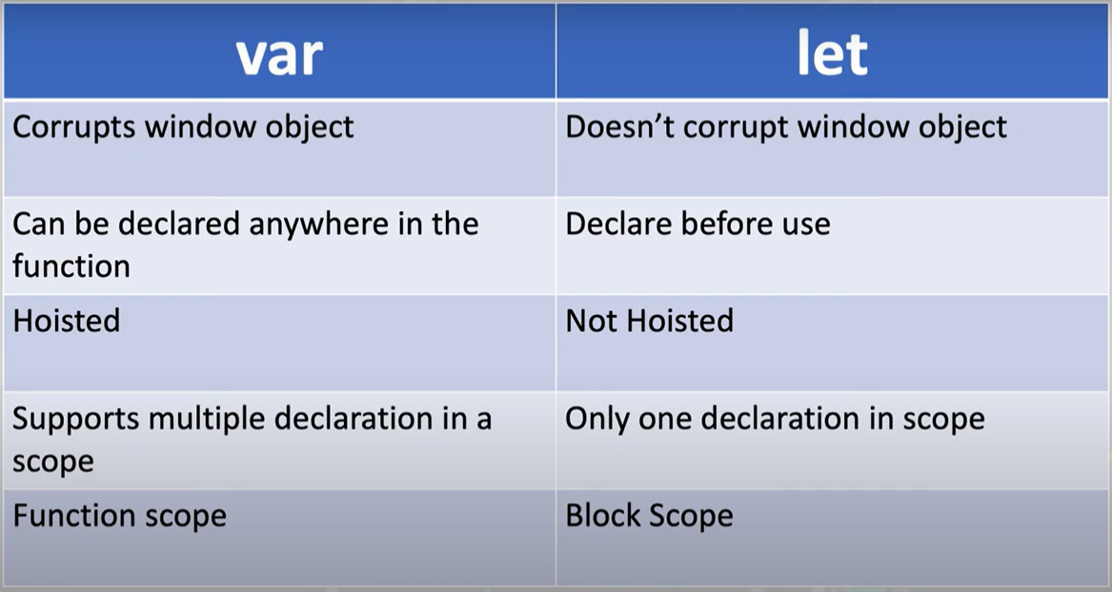
LET VAR CONST

Slide 30
OPERATORS IN JAVA SCRIPT
Arithmetic Operators:
+ (Addition)
- (Subtraction)
* (Multiplication)
/ (Division)
% (Modulus)
++ (Increment)
-- (Decrement)
Assignment Operators:
= (Assignment)
+= (Addition assignment)
-= (Subtraction assignment)
*= (Multiplication assignment)
/= (Division assignment)
%= (Modulus assignment)
Comparison Operators:
== (Equal to)
=== (Strict equal to)
!= (Not equal to)
!== (Strict not equal to)
> (Greater than)
< (Less than)
>= (Greater than or equal to)
<= (Less than or equal to)

Slide 31
OPERATORS IN JAVA SCRIPT
Logical Operators:
&& (Logical AND)
|| (Logical OR)
! (Logical NOT)
Unary Operators:
+ (Unary plus, converts to a number)
- (Unary minus, negates a number)
typeof (Returns a string representing the data type of a variable)
Example
let num = "5";
console.log(+num); // 5
console.log(-num); // -5
console.log(typeof num); // "string"
Conditional (Ternary) Operator:
? : (Conditional operator)
Example
let age = 18;
let canVote = (age >= 18) ? "Yes" : "No";

Slide 32
Java Script Conditions
If Statement
If else statement
if else ladder
If statement
if(expression){
//content to be evaluated
}

Slide 33
Java Script Conditions
If else statement
if(expression){
//content to be evaluated if condition is true
}
else{
//content to be evaluated if condition is false
}

Slide 34
Java Script Conditions
if else if statement
if(expression1){
//content to be evaluated if expression1 is true
}
else if(expression2){
//content to be evaluated if expression2 is true
}
else if(expression3){
//content to be evaluated if expression3 is true
}
else{
//content to be evaluated if no expression is true
}

Slide 35
Java Script Switch
The JavaScript switch statement is used to execute one code from multiple expressions
switch(expression){
case value1:
code to be executed;
break;
case value2:
code to be executed;
break;
......
default:
code to be executed if above values are not matched;
}

Slide 36
Java Script Loop
For Loop
The JavaScript for loop iterates the elements for the fixed number of times. It should be used if number of iteration is known.
for (initialization; condition; increment)
{
code to be executed
}

Slide 37
Java Script Loop
While Loop
he JavaScript while loop iterates the elements for the infinite number of times. It should be used if number of iteration is not known. The syntax of while loop is given below.
while (condition)
{
code to be executed
}

Slide 38
Java Script Loop
Do While Loop
The JavaScript do while loop iterates the elements for the infinite number of times like while loop. But, code is executed at least once whether condition is true or false. The syntax of do while loop is given below.
do{
code to be executed
}while (condition);

Slide 39
Java Script Loop
For in Loop
Ar=[1,2,3,4,5,6];
For (i in Ar){
Console.log(Ar[i])

Slide 40
Java Script Loop
forEach Loop
Ar={10,20,30,40,50};
Ar.forEach(function(value,index){
Conslo.log(value);
Conslo.log(index);
})
Obj=[{name:”appu”,age:20},{name:”allu”,age:23}]
Obj.forEach(function(value,index){
console.log(value);
console.log(value.name);
})

Slide 41
Java Script Break and Continue
Break
For(I=1;i<=10;++i)
{
If(i==5)
{
Break;
}
Console.log(i)
}

Slide 42
Java Script Break and Continue
Continue
For(I=1;i<=10;++i)
{
If(i==5)
{
Continue;
}
Console.log(i)
}

Slide 43
Java Script Function
JavaScript functions are used to perform operations. We can call JavaScript function many times to reuse the code.
There are mainly two advantages of JavaScript functions.
Code reusability: We can call a function several times so it save coding.
Less coding: It makes our program compact. We don’t need to write many lines of code each time to perform a common task.
Syntax :
function functionName([arg1, arg2, ...argN]){
//code to be executed
}
Explain about argument and retun in function and scope of variable

Slide 44
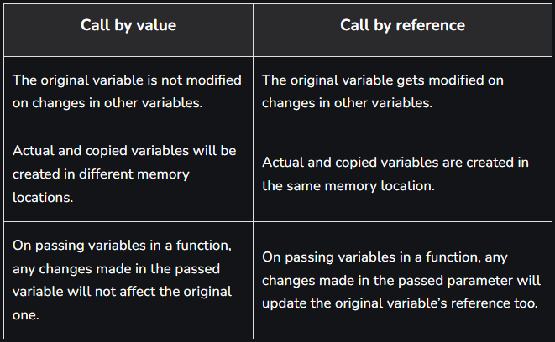
Call by value and call by referance

Slide 45
Call by value and call by refferance
CALL BY REFFERANCE
function asd(){
var a=[100];
bsd(a); console.log("function bsd = "+a[0]);
}
function bsd(a)
{
a[0]+=+1;
console.log("function asd = "+a[0]);
}
asd();
CALL BY VALUE
function asd(){
var a=100;
bsd(a); console.log("function bsd = "+a);
}
function bsd(a)
{
a+=+1;
console.log("function asd = "+a);
}
asd();

Slide 46
Closure in Java Script
Environment inside the function.
function asd(a,b){
function myFunction() {
c=a+b;
return c;
}
return myFunction;
}
// console.log(typeof(asd(5,4)));
let x=asd(5,4);
let val=x();
console.log(val);

Slide 47
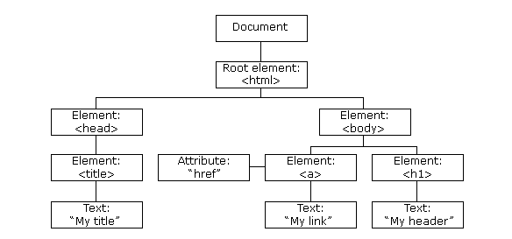
DOM (Document Object Model)
When a web page is loaded, the browser creates a Document Object Model of the page.
The HTML DOM model is constructed as a tree of Objects:

Slide 48
Methods of DOM
We can access and change the contents of document by its methods.
The important methods of document object are as follows:
Method | Description
getElementById() | returns the element having the given id value.
getElementsByTagName() | returns all the elements having the given tag name.
getElementsByClassName() | returns all the elements having the given class name.

Slide 49
Query Selector
Document.querySelector
Document.querySelectorAll
Document.querySelector(“#username”)// we can use class/id/tag name in this filed and return one value
eg:var a=document.querySelector(“.A”)
a.value=“good day”
Document.querySelectorAll(“.A”)//get all data with class name A and stored to an array
eg:var a=document.querySelectorAll(“.A”)
a[0].value=“good day”

Slide 50
Query Selector
=> Add two input and one button with same class name then we need only the input field class name then follow the code.
Document.querySelectorAll(“input.A”);
Document.querySelectorAll(“ button.A”);
=>Document.querySelectorAll(“ div >div >input”);

Slide 51
Event Handling
The change in the state of an object is known as an Event.
In html, there are various events which represents that some activity is performed by the user or by the browser
When javascript code is included in HTML, js react over these events and allow the execution.
This process of reacting over the events is called Event Handling. Thus, js handles the HTML events via Event Handlers.

Slide 52
Event Handling-Mouse Events
Event Performed | Event Handler | Description
click | onclick | When mouse click on an element
mouseover | onmouseover | When the cursor of the mouse comes over the element
mouseout | onmouseout | When the cursor of the mouse leaves an element
mousedown | onmousedown | When the mouse button is pressed over the element
mouseup | onmouseup | When the mouse button is released over the element
mousemove | onmousemove | When the mouse movement takes place.

Slide 53
Event Handling-Keyboard Events
Event Performed | Event Handler | Description
Keydown & Keyup | onkeydown & onkeyup | When the user press and then release the key

Slide 54
Event Listener
The addEventListener() method is used to attach an event handler to a particular element.
t does not override the existing event handlers.
Events are said to be an essential part of the JavaScript.
A web page responds according to the event that occurred.
Events can be user-generated or generated by API’s.
An event listener is a JavaScript's procedure that waits for the occurrence of an event.
The addEventListener() method is an inbuilt function of JavaScript.
We can add multiple event handlers to a particular element without overwriting the existing event handlers.
SYNTAX :-element.addEventListener(event, function, useCapture);

Slide 55
Event Listener
The onclick event generally occurs when the user clicks on an element.
It allows the programmer to execute a JavaScript's function when an element gets clicked.
This event can be used for validating a form, warning messages and many more.
Using JavaScript, this event can be dynamically added to any element. It supports all HTML elements except <html>, <head>, <title>, <style>, <script>, <base>, <iframe>, <bdo>, <br>, <meta>, and <param>.
It means we cannot apply the onclick event on the given tags.
In HTML, we can use the onclick attribute and assign a JavaScript function to it.
We can also use the JavaScript's addEventListener() method and pass a click event to it for greater flexibility.
In HTML :-<element onclick = "fun()">
In JavaScript :- object.onclick = function() { myScript };
In JavaScript by using the addEventListener() method :- object.addEventListener("click", myScript);

Slide 56
Event Listener
Example :-Using onclick attribute in HTML
<!DOCTYPE html>
<html>
<head>
<script>
function fun() { alert("Welcome to the javaTpoint.com"); }
</script>
</head>
<body>
<h3> This is an example of using onclick attribute in HTML. </h3>
<p> Click the following button to see the effect. </p>
<button onclick = "fun()">Click me</button>
</body>
</html>

Slide 57
Math Functions
Math.sqrt(number);
Math.round(10.5);
Math.ceil(10.2);//round to 11
Math.floor(10.7);//round to 10
Math.abs(-90);//return absolute value
Math.PI;//return value of PI
Math.max(10,20,30);// which return 30
Math.min(10,20,30);// which return 10
Math.pow(2,3);// return 8(2x2x2)

Slide 58
Synchronouse java script
In synchronous JavaScript, code is executed sequentially, one line at a time. Each line of code must complete before the next one starts. If there's an operation that takes a significant amount of time, like a network request or reading a large file, it can block the entire execution, making the program appear unresponsive.
Example
console.log("Start");
function synchronousTask() {
for (let i = 0; i < 3; i++) {
console.log(`Synchronous Task ${i}`);
}
}
synchronousTask();
console.log("End");

Slide 59
Asynchronouse java script
In asynchronous JavaScript, code doesn't necessarily execute sequentially. It allows tasks to be performed concurrently without blocking the main thread of execution. Asynchronous operations are often used for I/O-bound tasks like fetching data from a server or handling user input.
Example
console.log("Start");
function asynchronousTask() {
setTimeout(function () {
console.log("Asynchronous Task");
}, 2000); // Wait for 2 seconds
}
asynchronousTask();
console.log("End");

Slide 60
Timers
Two type of functions for timers.
setInterval(function (){
Body of function;
},time(1000-1sec))
Eg :-
setInterval(function(){
document.write(“*”)
},1000);
Eg 2 :-
Var i=0;
Var x=setinterval(function(){
document.write(“*”);
i++;
if(i==10)
{
clearInterval(x);
},1000)

Slide 61
Timers
setTimeOut(function(){
body of function;
},1000)
Function abc(){
setTimeOut(function(){
document.write(“*”)
},100)
}
Function abc(){
setTimeOut(function(){
document.write(“*”);
abc();
},100)
}
Var i=0;
Function abc(){
setTimeOut(function(){
i++;
document.write(“*”);
if(i<=20){abc();}
},100)
}

Slide 62
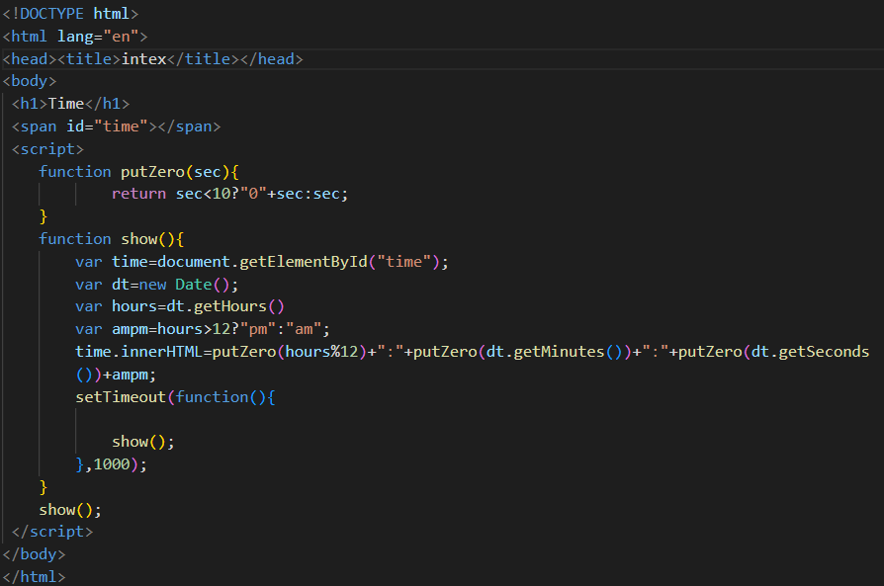
Date & Time UsingTimers

Slide 63
Anonymous Function
In JavaScript, an anonymous function is a function that doesn't have a name. Instead of defining a named function with the function keyword, you can create an anonymous function directly as an expression. Anonymous functions are often used as callback functions or for one-off tasks. There are two common ways to create anonymous functions in
Example:
var anonymousFunction = function()
{
console.log("This is an anonymous function.");
};
// You can then call it like any other function
anonymousFunction();

Slide 64
Arrow Function
Arrow functions are introduced in ES6.
Arrow functions are anonymous functions (the functions without a name and not bound with an identifier).
They don't return any value and can declare without the function keyword.
Syntax : const functionName = (arg1, arg2, ?..) => {
//body of the function
}

Slide 65
Arrow Function Continue…
// function expression
var myfun1 = function show() {
console.log("It is a Function Expression"); }
// Anonymous function
var myfun2 = function () {
console.log("It is an Anonymous Function"); }
//Arrow function
var myfun3 = () => {
console.log("It is an Arrow Function"); };
myfun1();
myfun2();
myfun3();

Slide 66
Spread Operator
ES6 introduced a new operator referred to as a spread operator, which consists of three dots (...). It allows an iterable to expand in places where more than zero arguments are expected.
Syntax
var variablename1 = [...value];
Example
Example2 :-
Var a=[10,20,30,40,50,60];
Math.max(…a);
Object :-
var obj={a:1,b:2,c:3,d:4};
var obj2={…obj};
console.log(obj);
console.log(obj2);
Array :-
var arr=[1,2,3,4,5,6]
var arr2=[…arr];
console.log(arr);
console.log(arr2);

Slide 67
Destructuring
Destructuring means to break down a complex structure into simpler parts.
With the syntax of destructuring, you can extract smaller fragments from objects and arrays.
It can be used for assignments and declaration of a variable.
“Destructuring is an efficient way to extract multiple values from data that is stored in arrays or objects.”
Object Example :-
const obj={name:”Appu”,age:21,class:”10th”};
const name=obj.name;
Const age=obj.age;
Const class=obj.class;
Console.log(name,age,class);
Object wit Destructuring Example :-
Var {name:”Appu”,age:21,class:”10th”};
Var {name,age,class}=obj;
Console.log(name,age,class);

Slide 68
Destructuring
Array Example :-
const arr[10,20,30,40];
const a=arr[0];
Const b=arr[1];
Const c=arr[2];
Console.log(name,age,class);
Array wit Destructuring Example :-
Var arr=[10,20,30,40];
Var [a,b,c]=arr;
Console.log(a,b,c);
We can destructure using argument in function.
Const mark=[1,2,3,4]
Function myFunction([a,b,c,d]){
console.log(a,b,c,d);
}
myFunction(marks);
Var obj1={
name : “Synnefo”,
place: “kochin”
rank : 100
}
Function myFunction{name,place}){
console.log(name,place);
}
myFunction(obj1);

Slide 69
Nested Destructuring
.
Object wit Destructuring Example :-
Var obj={name:”Appu”,age:21,class:”10th”
subject:{teacher:”rakhi”}
};
Var {name,age,class,subject:{teacher}}=obj;
Console.log(name,age,class);
Array wit Destructuring Example :-
Var arr=[{name:”Appu”,age:21,class:10},10,20,30,40];
Var [{name,age,class},a,b,c]=arr;
Console.log(a,b,c);

Slide 70
Array Functions
Arr=[
{
name:”amal”,mark:49, place:”malappuram”
},
{
name:”anil”, mark:48, place:”ernakulam”
},
{
name:”avin”, mark:50, place:”alappuzha”
},
{
name:”akhil”, mark:39, place:”kollam”
}
]
Console.log(arr);

Slide 71
Array Functions
forEach
Arr.forEach((item,index)=>{
console.log(item);// console.log(item.name);
});
The JavaScript array forEach() method is used to invoke the specified function once for each array element.
Find
const x= Arr.find((item)=>{
return item.name===“anil”;//the condition satisfied in first element will return
});
Console.log(x)
The JavaScript array find() method returns the first element of the given array that satisfies the provided function condition.
Filter
const x= Arr.filter((item,index)=>{
return item.mark<49;//the condition satisfied in all element will return
});
Console.log(x);
The JavaScript array filter() method filter and extract the element of an array that satisfying the provided condition. It doesn't change the original array.

Slide 72
Array Functions
Map()
const x= Arr.map((item)=>{
return item.name;
//return{
// …arr,country:”india”
//};
});
Console.log(x)
The JavaScript array map() method calls the specified function for every array element and returns the new array. This method doesn't change the original array.
reduce()
const value= Arr.reduce((total,item)=>{
//return item.mark;
return total+item.mark;
},0);
Console.log(value)
The reduce() method reduces the given array into a single value by executing a reducer function. The user implements the reducer function that works on every element present in the array.

Slide 73
This KeyWord
The this keyword is a reference variable that refers to the current object. Here, we will learn about this keyword with help of different examples.
* Var obj={a:1,b:2,c:function(){console.log(“hello”)}};
Console.log(obj);
* var obj={a:1,b:2,c:function(){console.log("hello");}}
obj.c();
* var obj={a:1,b:2,c:function(){console.log(this);}} obj.c();
* var obj={a:1,b:2,c:function(){console.log(this);}} var aa=obj.c;
aa()
//in case of arrow function the parent function is not define then the Parent context will be window
* var obj={a:1,b:2,c:()=>{console.log(this);}} obj.c();

Slide 74
This KeyWord
Call(),bind()
The call() and bind() method allows us to write a method that can be used on different objects.
The context will be set at the call time
* var obj={a:1,b:2,c:function(){console.log(this);}} var aa=obj.c;
aa.call(obj)
The context will be set at the create time
The bind() will create new object
* var obj={a:1,b:2,c:function(){console.log(this);}} obj.c=obj.c.bind(obj);
var aa=obj.c;
aa();

Slide 75
OOP
CLASS
In JavaScript, classes are the special type of functions. We can define the class just like function declarations and function expressions.
The JavaScript class contains various class members within a body including methods or constructor
The class is executed in strict mode. So, the code containing the silent error or mistake throws an error.

Slide 76
OOP
Using Object
var stud1={name:"alan",YOB:1996,
getAge:function(){return new Date().getFullYear()-this.YOB;},
getName:function(){return this.name;}}
var stud2={name:"amal",YOB:2000,
getAge:function(){return new Date().getFullYear()-this.YOB;},
getName:function(){return this.name;}}
var stud3={name:"avin",YOB:1998,
getAge:function(){return new Date().getFullYear()-this.YOB;},
getName:function(){return this.name;}}
console.log(stud1.getAge(),stud1.getName());
console.log(stud2.getAge(),stud2.getName());
console.log(stud3.getAge(),stud3.getName());

Slide 77
OOP
CLASS
Class Student{
Name;
Yob;
Constructor(name,yob){
This.name=name;
This.yob=yob
}
getAge(){return new Date().getFullYear()-this.YOB;};
getName(){return this.name;};
}
var stud1=new Student(“kichu”,2010);
var stud2=new Student(“vichu”,2015);
var stud3=new Student(“sachu”,2019); console.log(stud1);
console.log(stud2);
console.log(stud3);

Slide 78
OOP
SETTER & GETTER
Getters and setters are the special class method that is used to read and write access to an object's properties.
The getter method is used to reads the value of the variable or retrieve the value and setter method is used to set or initialize respective class fields.

Slide 79
OOP
Before SETTERS
<script>
class Button{
constructor(name){
this.button=document.createElement('button');
this.button.innerHTML=name;
document.body.appendChild(this.button);
}
setWidth(width){
this.button.style.width=width+'px';
}
setHeight(height){
this.button.style.height=height+'px';
} } var btn1=new Button("click Me")
btn1.setWidth(100);
btn1.setHeight(100); </script>

Slide 80
OOP
After SETTERS
<script>
class Button{
constructor(name){
this.button=document.createElement('button');
this.button.innerHTML=name;
document.body.appendChild(this.button);
}
set width(width){
this.button.style.width=width+'px';
}
set height(height){
this.button.style.height=height+'px';
}
}
var btn1=new Button("click Me");
btn1.width=100;
btn1.height=100;
</script>

Slide 81
OOP
Before Getters
<script>
class Button{
constructor(name){
this.button=document.createElement('button');
this.button.innerHTML=name;
document.body.appendChild(this.button);
}
set width(width){
this.button.style.width=width+'px';
}
set height(height){
this.button.style.height=height+'px';
}
}
var btn1=new Button("click Me");
btn1.width=100;
btn1.height=100;
</script>

Slide 82
OOP
After Getters
class Button{
constructor(name){
this.button=document.createElement('button');
this.button.innerHTML=name;
document.body.appendChild(this.button);
}
set width(width){
this.button.style.width=width+'px';
}
set height(height){
this.button.style.height=height+'px';
}
get width(){
return parseInt(this.button.style.width);
}
get height(){
return parseInt(this.button.style.height);
}
}
var btn1=new Button("click Me");
btn1.width=100;
btn1.height=100;
console.log(btn1.width,btn1.height);

Slide 83
OOP
INHERITANCE
The JavaScript inheritance is a mechanism that allows us to create new classes on the basis of existing classes.
Inheritance provides flexibility to the child class to reuse the methods and variables of a parent class.
The extends keyword is used in class expressions or class declarations.
Using extends keyword, we can acquire all the properties and behavior of the inbuilt object as well as custom classes.
The super keyword is used to call the constructor of its parent class to access the parent's properties and methods.

Slide 84
OOP
INHERITANCE
class Bike
{
constructor()
{
this.company="Honda";
}
}
class Vehicle extends Bike {
constructor(name,price) {
super();
this.name=name;
this.price=price;
}
}
var v = new Vehicle("Shine","70000");
document.writeln(v.company+" "+v.name+" "+v.price);

Slide 85
OOP
Types of Inheritance:
Single Inheritance: A class or object inherits from a single parent class or object. This is the most common form of inheritance in JavaScript and is demonstrated in the above example.
Multiple Inheritance: A class or object can inherit from multiple parent classes or objects. JavaScript doesn't support multiple inheritance directly, but you can simulate it using a technique called "mixins" or by using composition (combining multiple objects).
Multilevel Inheritance: In this type, a class inherits from a parent class, and another class inherits from the child class, forming a chain. This creates a hierarchy of inheritance.
Hierarchical Inheritance: Multiple child classes inherit from a single parent class. Each child class can have its own specialized behavior while sharing common characteristics from the parent.

Slide 86
OOP
PROTOTYPE
JavaScript is a prototype-based language that facilitates the objects to acquire properties and features from one another. Here, each object contains a prototype object.
In JavaScript, whenever a function is created the prototype property is added to that function automatically.
This property is a prototype object that holds a constructor property.
class Button{
constructor(name){
this.button=document.createElement("button");
this.button.innerHTML=name;
document.body.appendChild(this.button);
}
onClick(fn){
this.button.onclick=fn;
}
}
var obj1=new Button('click me');
console.log(obj1);

Slide 87
OOP
PROTOTYPE
function myButton(name){
this.button=document.createElement("button");
this.button.innerHTML=name;
document.body.appendChild(this.button);
}
myButton.prototype.onclick= function(fn){
this.button.onclick=fn;
}
var obj2=new myButton('YO!');
console.log(obj2);
obj2.onclick(function(){
console.log("clicked");
})

Slide 88
TRY-CATCH
In JavaScript, the try...catch statement is used for error handling. It allows you to gracefully handle exceptions (errors) that may occur during the execution of your code, preventing your program from crashing. Here's how it works, along with an example:
try {
// Code that may cause an exception
} catch (error) {
// Code to handle the exception
} finally {
// Code that always runs, whether there was an exception or not (optional)
}
The try block contains the code that you suspect might throw an exception.
If an exception occurs in the try block, control is transferred to the catch block.
The catch block contains code that handles the exception. The error parameter represents the exception object, which you can use to gather information about the error.
Optionally, you can use a finally block to specify code that should always run, regardless of whether an exception occurred or not. This block is often used for cleanup tasks.

Slide 89
TRY-CATCH
EXAMPLE :
try {
// Attempt to execute code that might throw an exception
const result = 10 / 0; // This will throw a "division by zero" error
console.log("Result:", result); // This line will not be executed
} catch (error) {
// Handle the exception
console.error("An error occurred:", error.message);
} finally {
// This block will always run
console.log("Cleanup or finalization code.");
}
console.log("Program continues after handling the exception.");

Slide 90
CallBack Function
A callback function, often simply referred to as a "callback," is a function that is passed as an argument to another function and is executed after the completion of that function. Callbacks are commonly used in asynchronous programming and event handling to ensure that certain code is executed at the appropriate time.
CallBack Function(Synchronous)
// Example 1: Synchronous Callback
function greet(name, callback) {
console.log(`Hello, ${name}!`);
callback(); // Call the callback function after greeting
function sayGoodbye() {
console.log("Goodbye!");
}
greet("Alice", sayGoodbye);
Synchronous callback

Slide 91
CallBack Function
CallBack Function(Asynchronous)
// Example 2: Asynchronous Callback
function delayedGreet(name, callback) {
setTimeout(function () {
console.log(`Hello, ${name}!`);
callback(); // Call the callback
function after a delay
}, 2000); // Delay for 2 seconds}
function sayGoodbye() {
console.log("Goodbye!");
}
delayedGreet("Bob", sayGoodbye);
Asynchronous callback

Slide 92
CallBack Hell
"Callback hell" in JavaScript refers to a situation where multiple nested callback functions make the code difficult to read and maintain, leading to code that is complex and hard to follow. It primarily occurs in asynchronous code, such as when working with callbacks, promises, or async/await, where one asynchronous operation depends on the result of another. Callback hell is also sometimes called "pyramid of doom" or "callback pyramid.“
EG:
getUser(function (user) {
getPosts(user.id, function (posts) {
getComments(posts[0].id, function (comments) {
// Do something with comments
});
});
});

Slide 93
Promise
In JavaScript, a promise is an object that represents the eventual completion or failure of an asynchronous operation, typically used for handling asynchronous tasks like fetching data from a server, reading files, or any other operation that may take some time to complete. Promises make it easier to write clean and readable asynchronous code. Promises have three states: pending, fulfilled, and rejected.
Promise chaining
Promise chaining is a technique in JavaScript that allows you to work with asynchronous operations in a more readable and organized way. It involves chaining multiple .then() and .catch() methods on a Promise object to handle the results and errors of asynchronous operations sequentially. Each .then() returns a new Promise, making it possible to chain multiple asynchronous operations one after the other.

Slide 94
Promise Example
const fetchData = () => {
return new Promise((resolve, reject) => {
setTimeout(() => {
const data = { message: 'Data fetched successfully' };
resolve(data);
}, 2000);
});
};
fetchData().then((result) => {
console.log('Success:', result);
}).catch((error) => {
console.error('Error:', error);
});

Slide 95
Async Await
async and await are keywords in JavaScript used to work with asynchronous code. They make it easier to write and manage code that involves operations such as fetching data from a server, reading files, or any other task that might take some time to complete.
example
async function fetchData() {
try {
const response = await fetch('https://jsonplaceholder.typicode.com/todos/1');
const data = await response.json();
console.log(data);
} catch (error) {
console.error('Error fetching data:', error);
}
}
fetchData();

Slide 96
Import export
In JavaScript, you can use the import and export statements to work with modules. Modules help you organize and structure your code by breaking it into smaller, reusable pieces.
Export Function
// math.js
export function add(a, b) {
return a + b;
}
export function subtract(a, b) {
return a - b;
}
Import Function
// main.js
import { add, subtract } from './math.js';
const result1 = add(5, 3);
console.log(`5 + 3 = ${result1}`);
const result2 = subtract(10, 4);
console.log(`10 - 4 = ${result2}`);

Slide 97
Regular Expression
[cr]at//it will be check cat and rat
- //(a-z,0-9)
^-start of string /^cat/i
$-end of the string/meat$/
‘m’ used to find the word in end of line /meat$/im
? –optional (0 or 1) /meats?$/I it return meat and meats
()-grouping /fish(es)?$/I
* (0 or may) optional /meats*$/i
+(1 or many) /meats+$/
. Any character /meat.+$/
[^]-not /[^hello]/
{} /l{2}o$/ hello
{} /l{2,6}0$/ {range},{2,} 2 or more
\d digit(0-9)

Slide 98
Regula Expression
. All
()capture group
(?:)non capture group

Slide 99


